Slide 1
SNPP 2013-05-20 Flight
S-HIS BT Plots, Including Turn Regions
(No Roll and Pitch Filtering)
UW SSEC

Slide 2
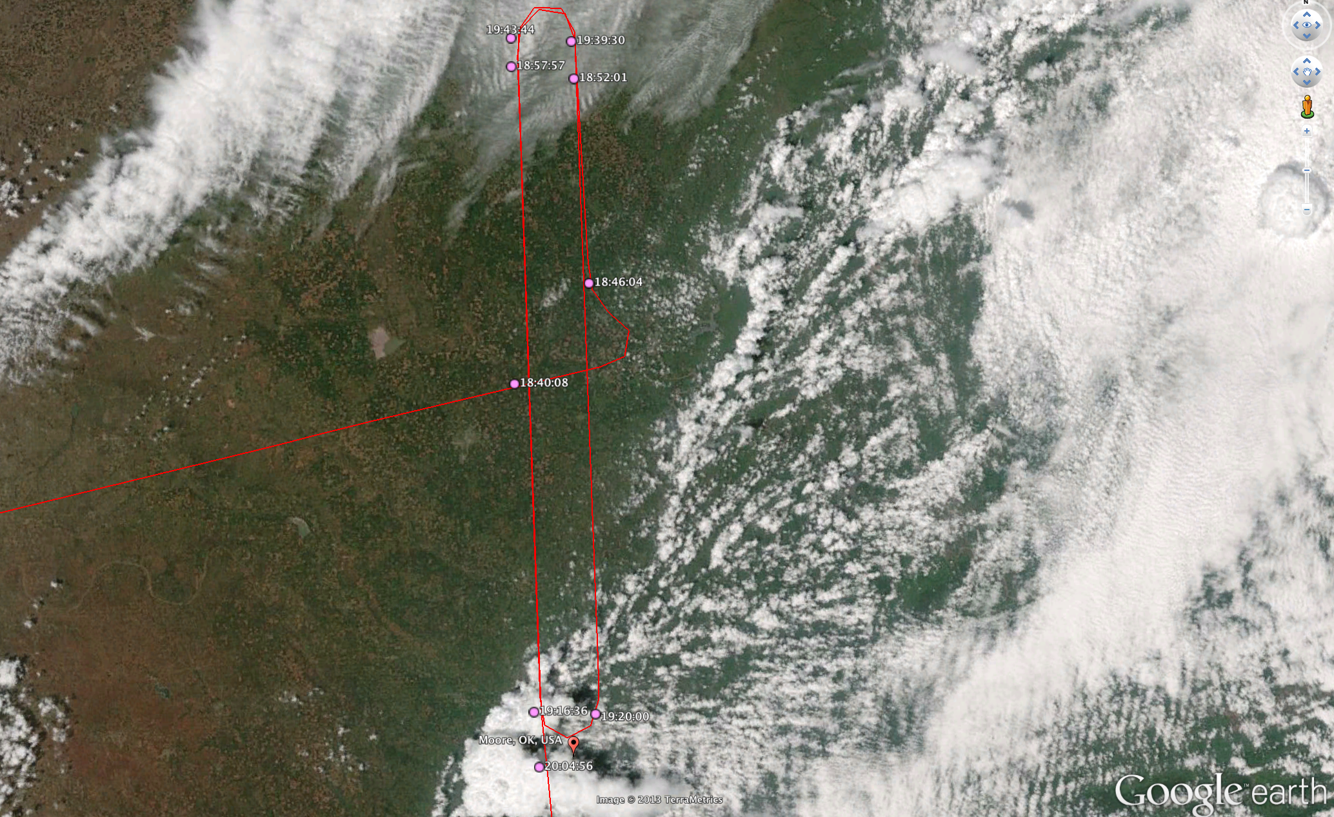

ER-2 Track Near CART Site and Moore OK

Slide 3
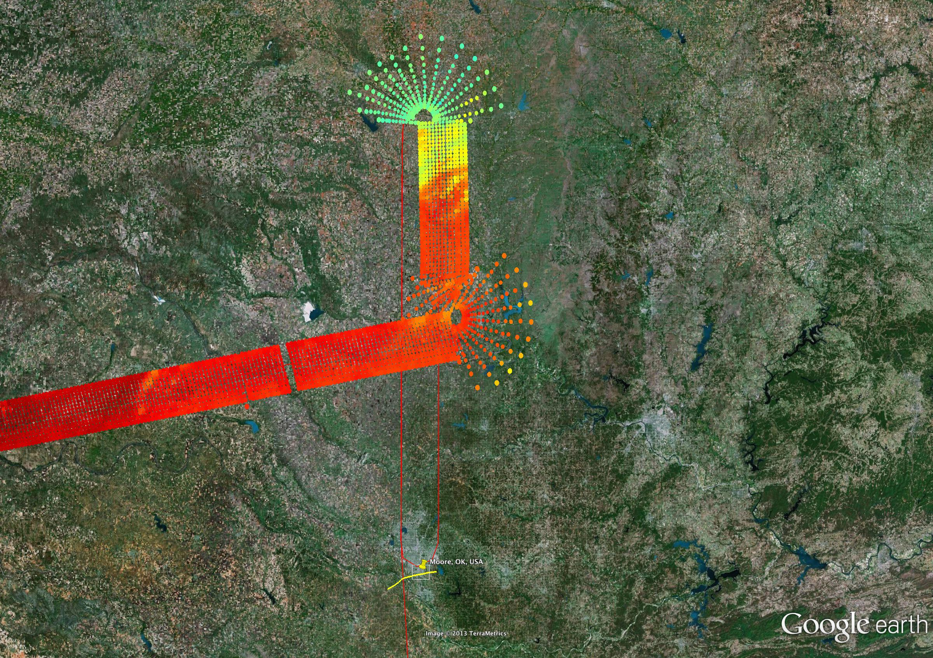
S-HIS 895-900 cm⁻¹ Brightness Temperature (200 – 320K)

Slide 4
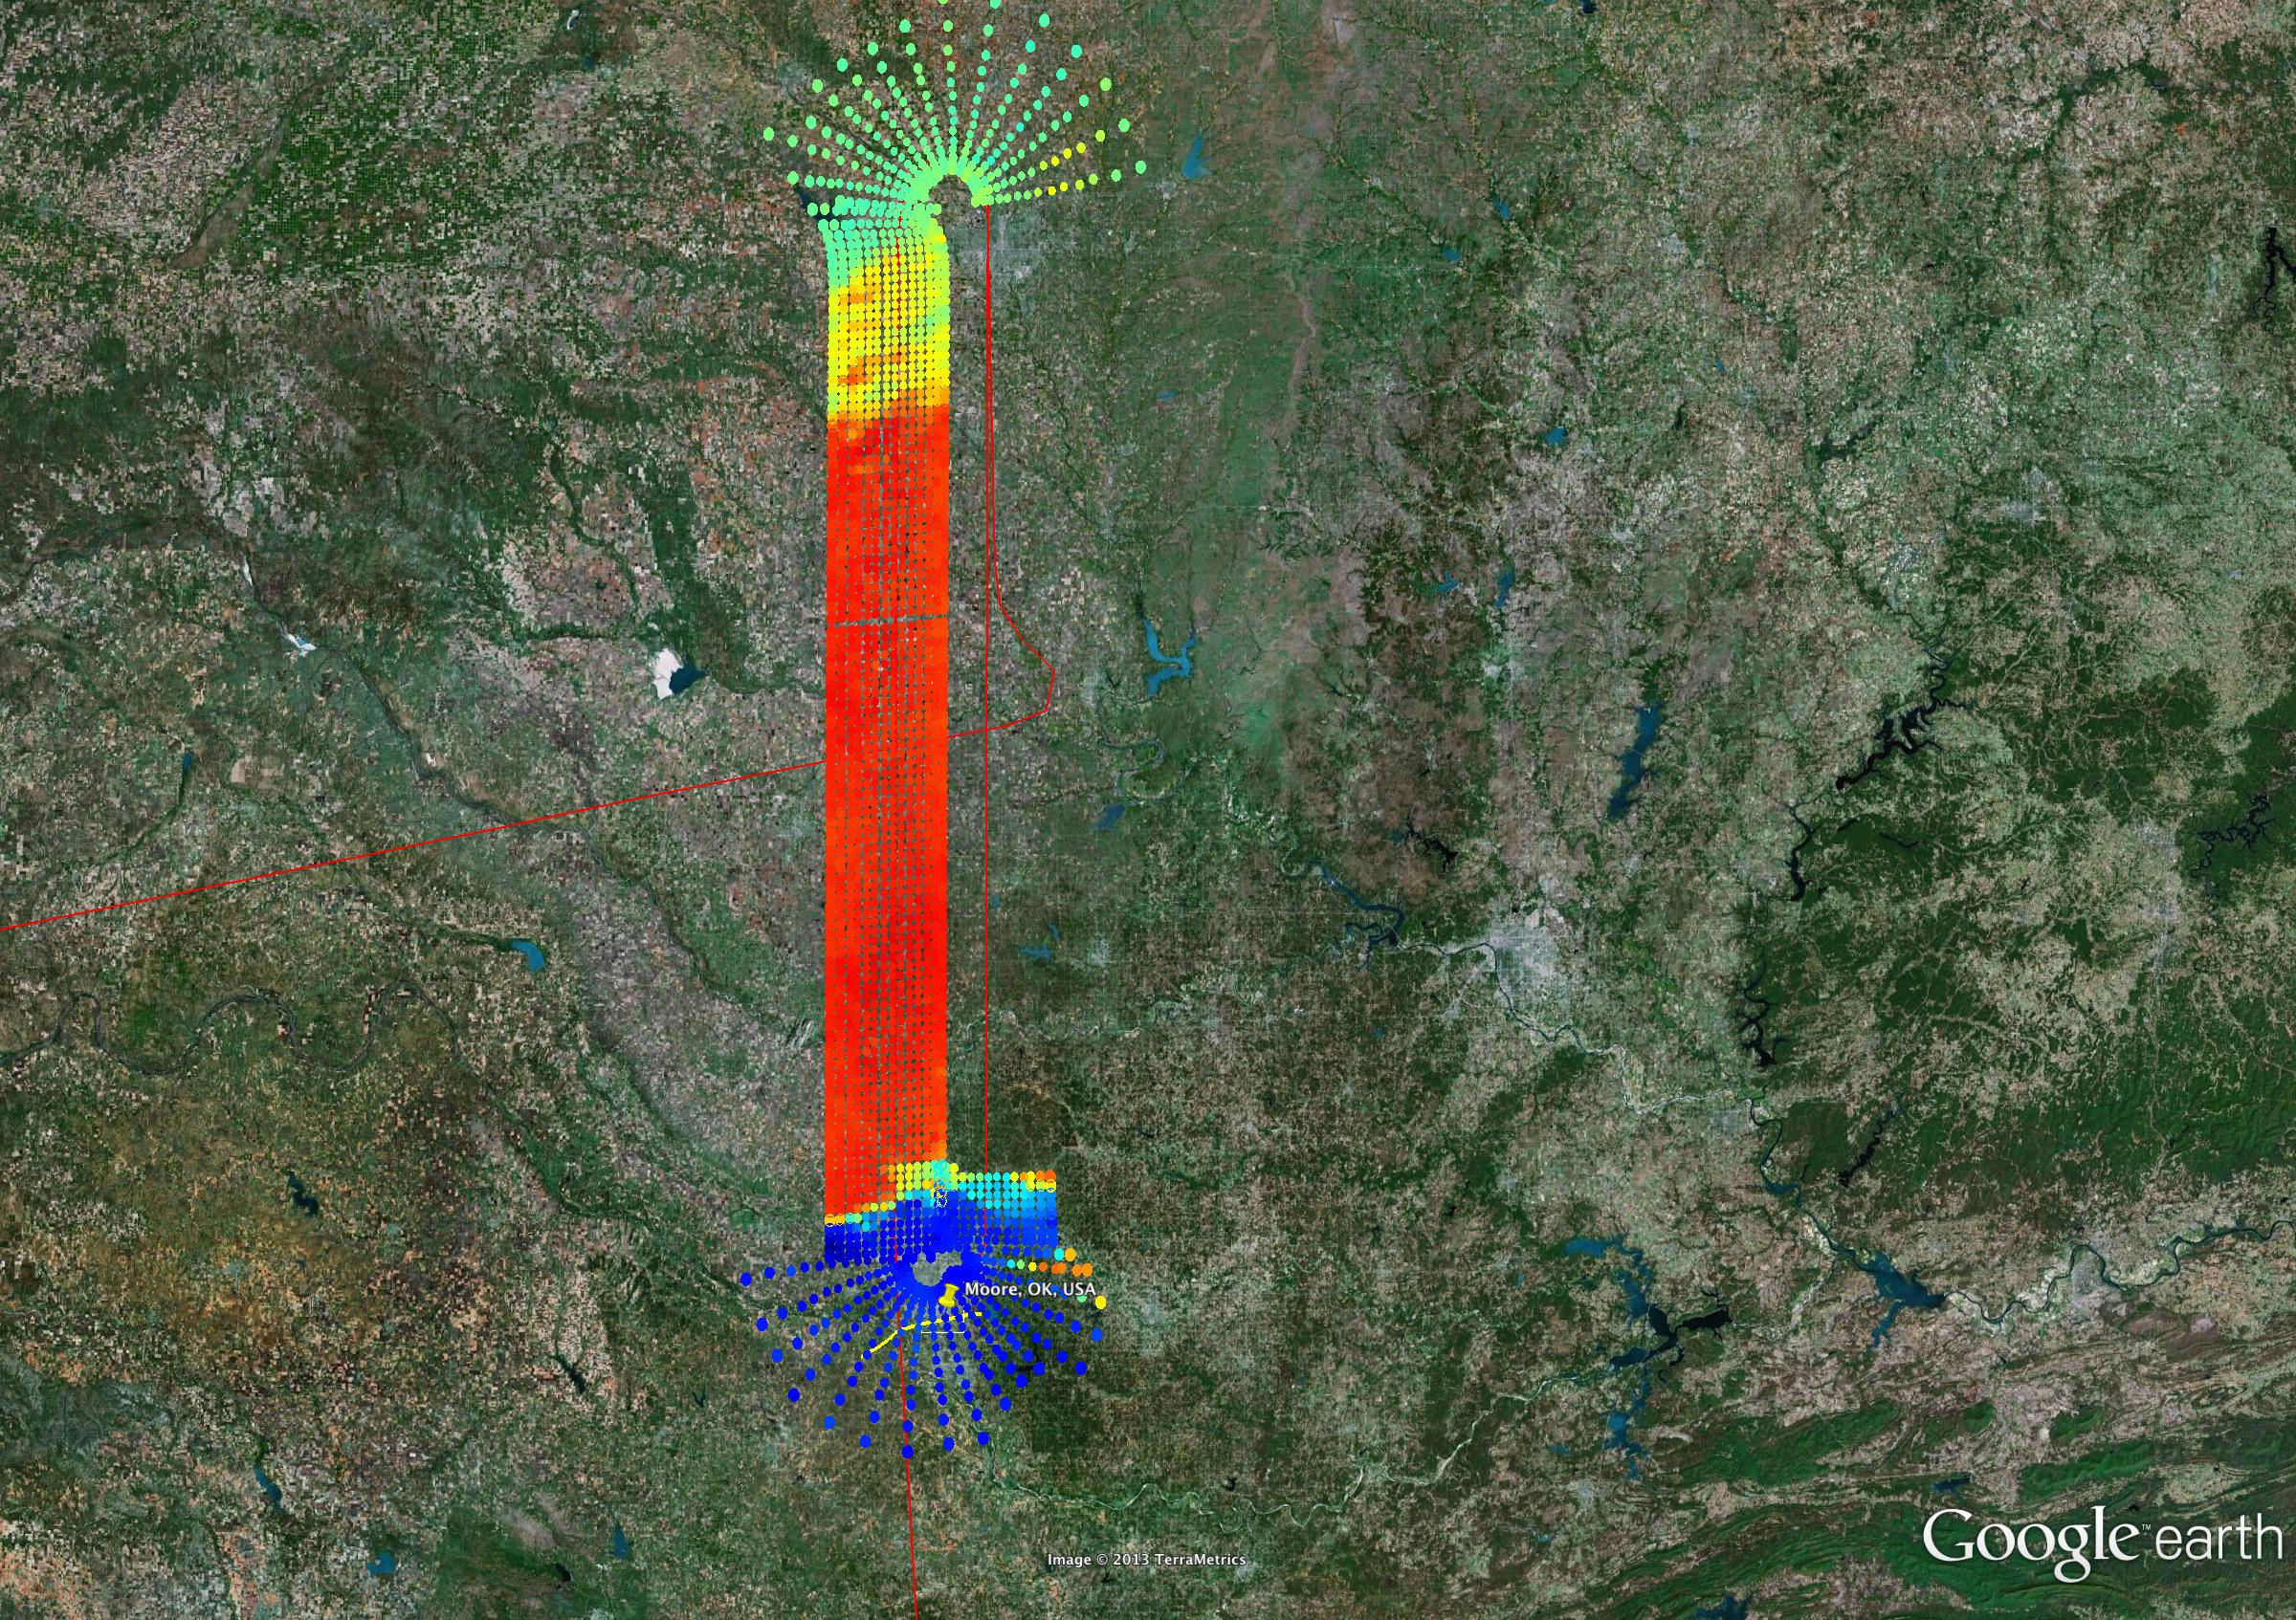
S-HIS 895-900 cm⁻¹ Brightness Temperature (200 – 320K)

Slide 5
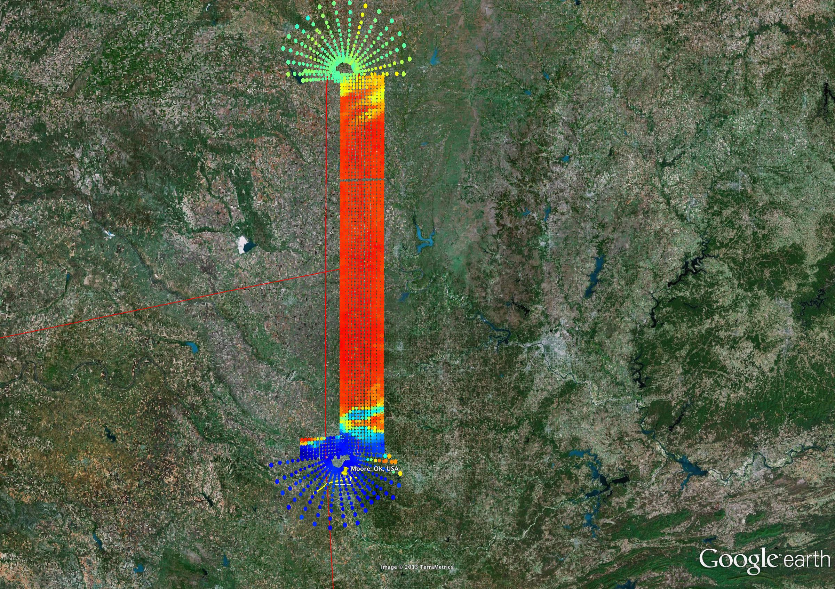
S-HIS 895-900 cm⁻¹ Brightness Temperature (200 – 320K)

Slide 6
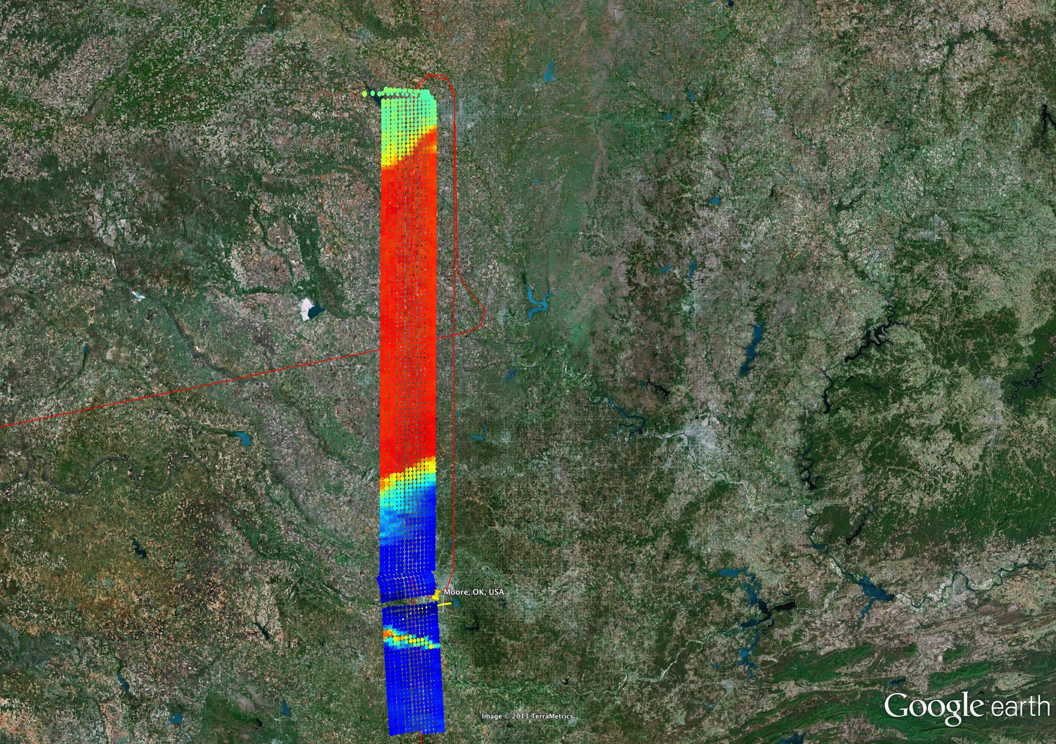
S-HIS 895-900 cm⁻¹ Brightness Temperature (200 – 320K)

Slide 7
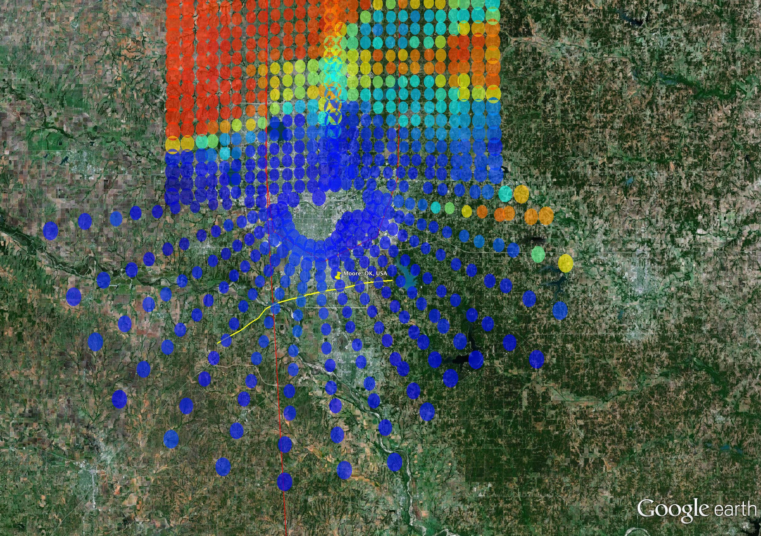
S-HIS 895-900 cm⁻¹ Brightness Temperature (200 – 320K)
First Pass Near Moore
~19:18 UTC
Tornado Centerline Shown
In Yellow
(NOAA Preliminary)

Slide 8
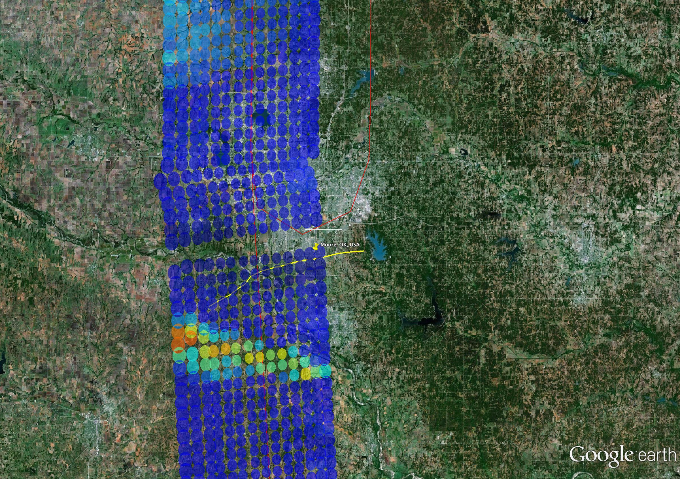
S-HIS 895-900 cm⁻¹ Brightness Temperature (200 – 320K)
Second Pass Near Moore
~20:04 UTC
Tornado Centerline Shown
In Yellow
(NOAA Preliminary)

