Slide 1
SNPP 2013-05-20 Flight S-HIS BT Plots
UW SSEC

Slide 2
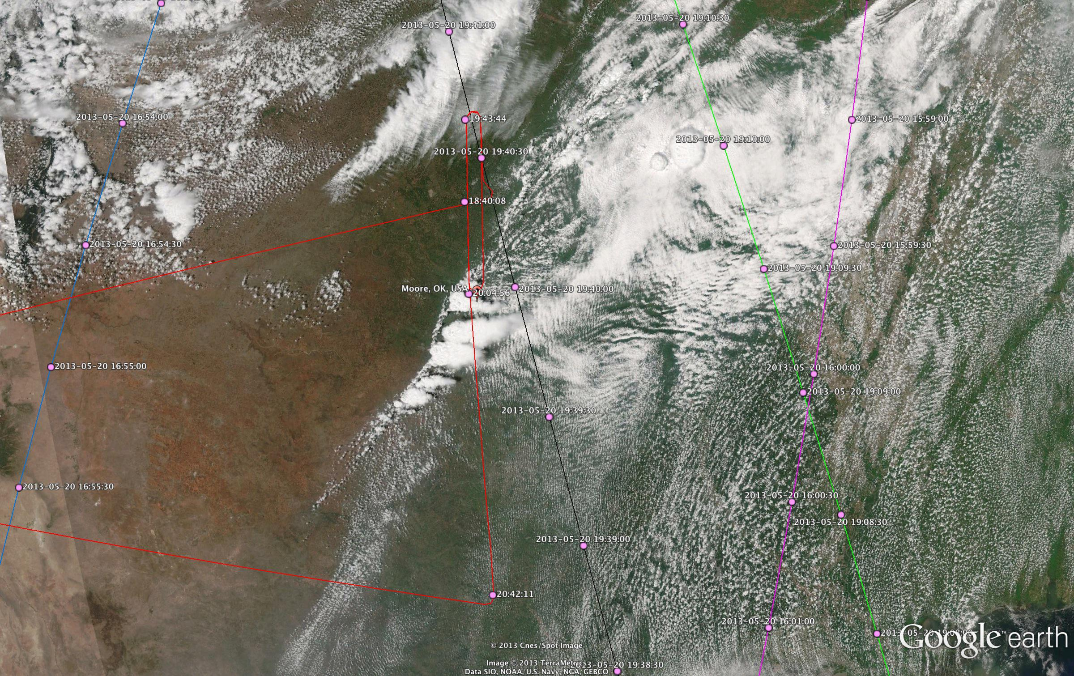

ER-2, METOP-A, METOP-B, AQUA, and NPP Tracks

Slide 3
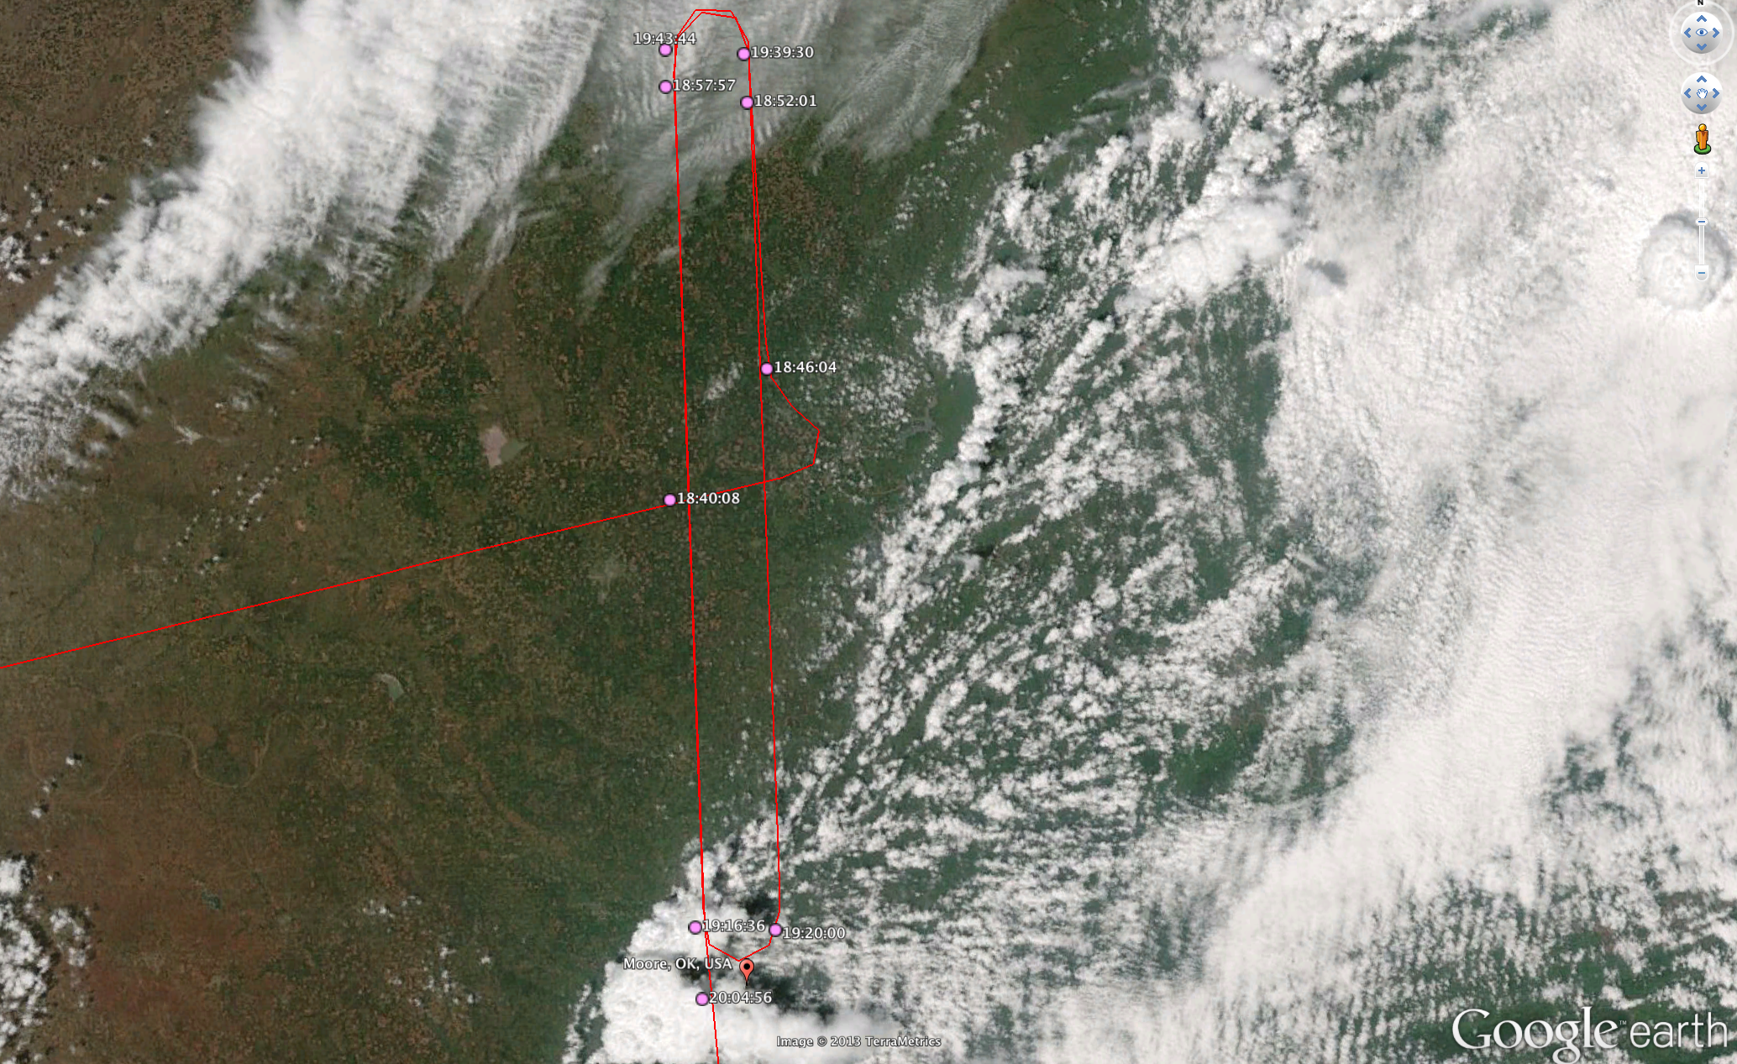
ER-2 Track Near CART Site and Moore OK

Slide 4
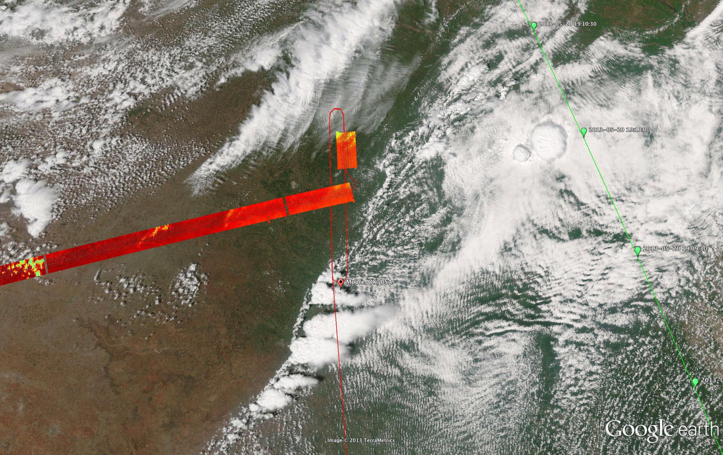
S-HIS 895-900 cm⁻¹ Brightness Temperature (200 – 320K)

Slide 5
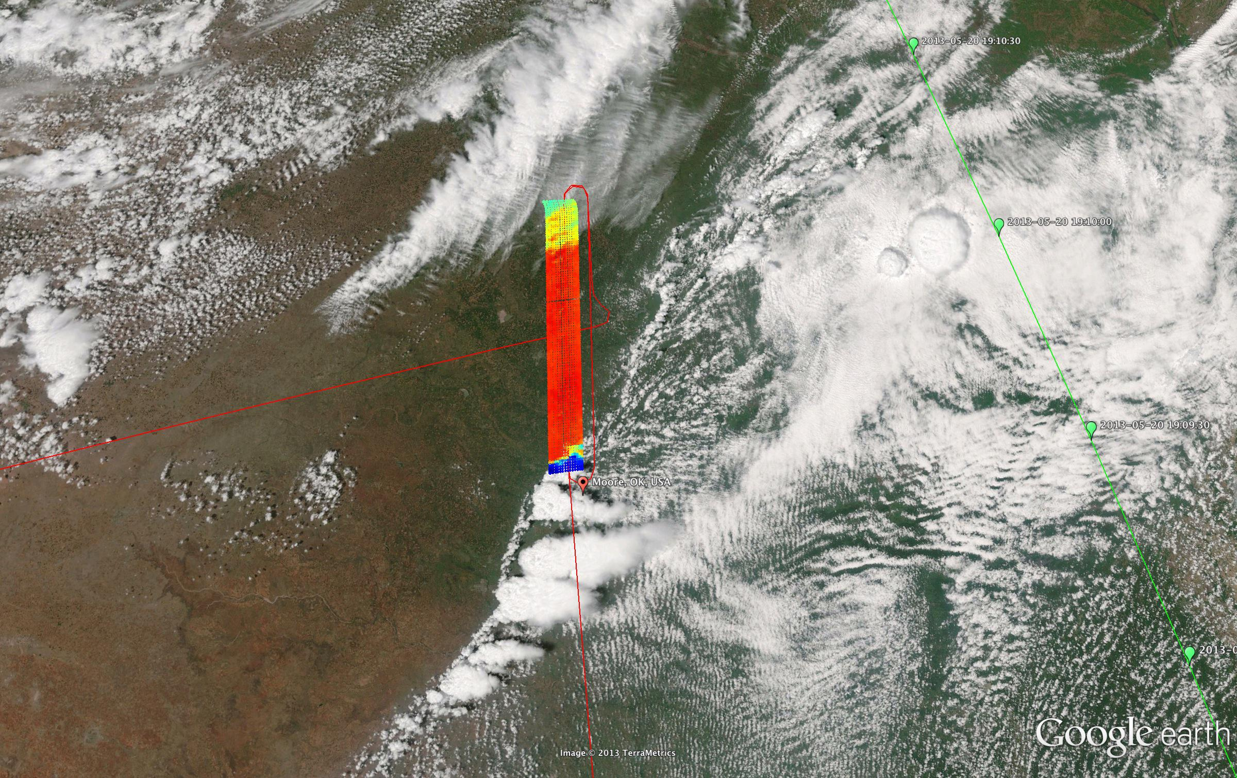
S-HIS 895-900 cm⁻¹ Brightness Temperature (200 – 320K)

Slide 6
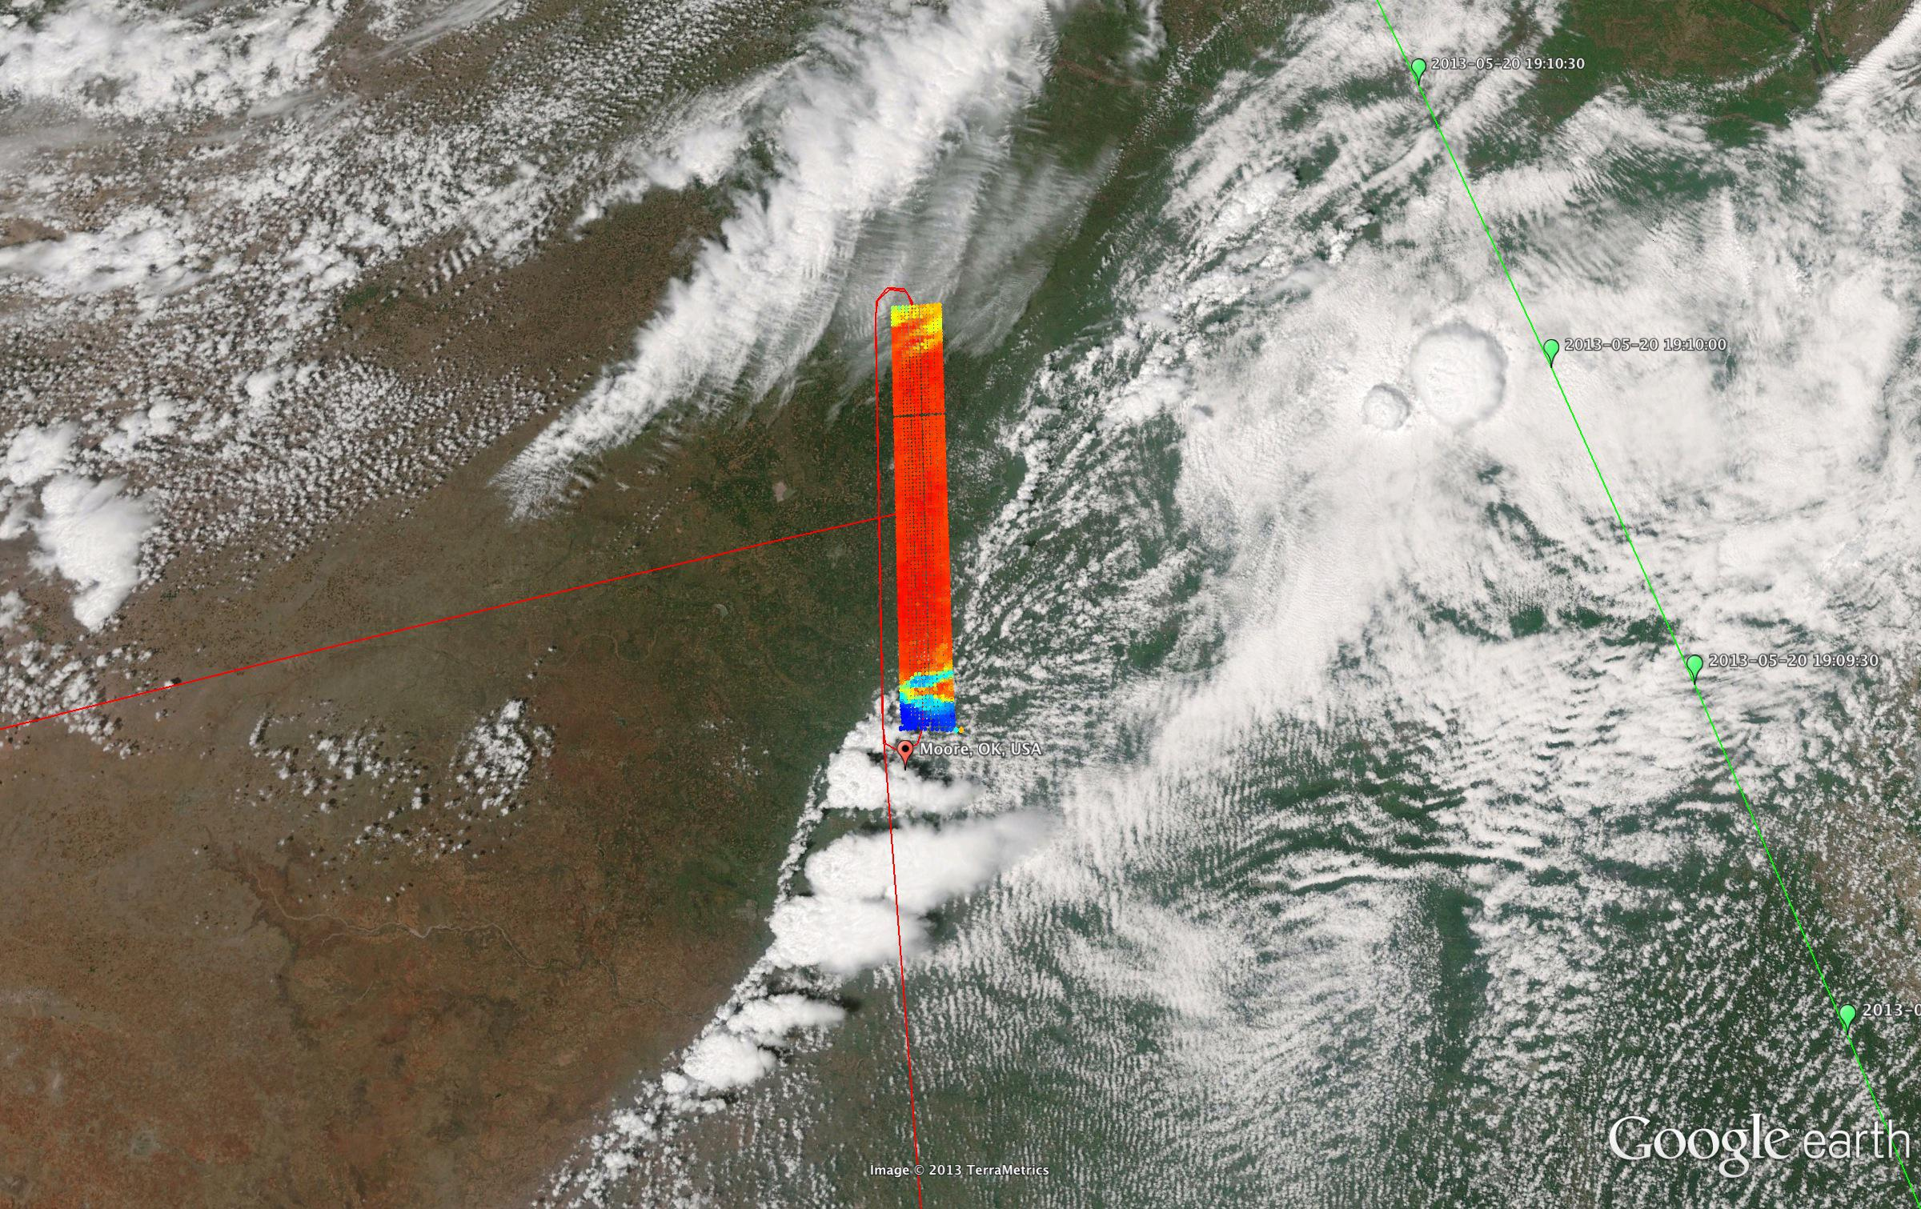
S-HIS 895-900 cm⁻¹ Brightness Temperature (200 – 320K)

Slide 7
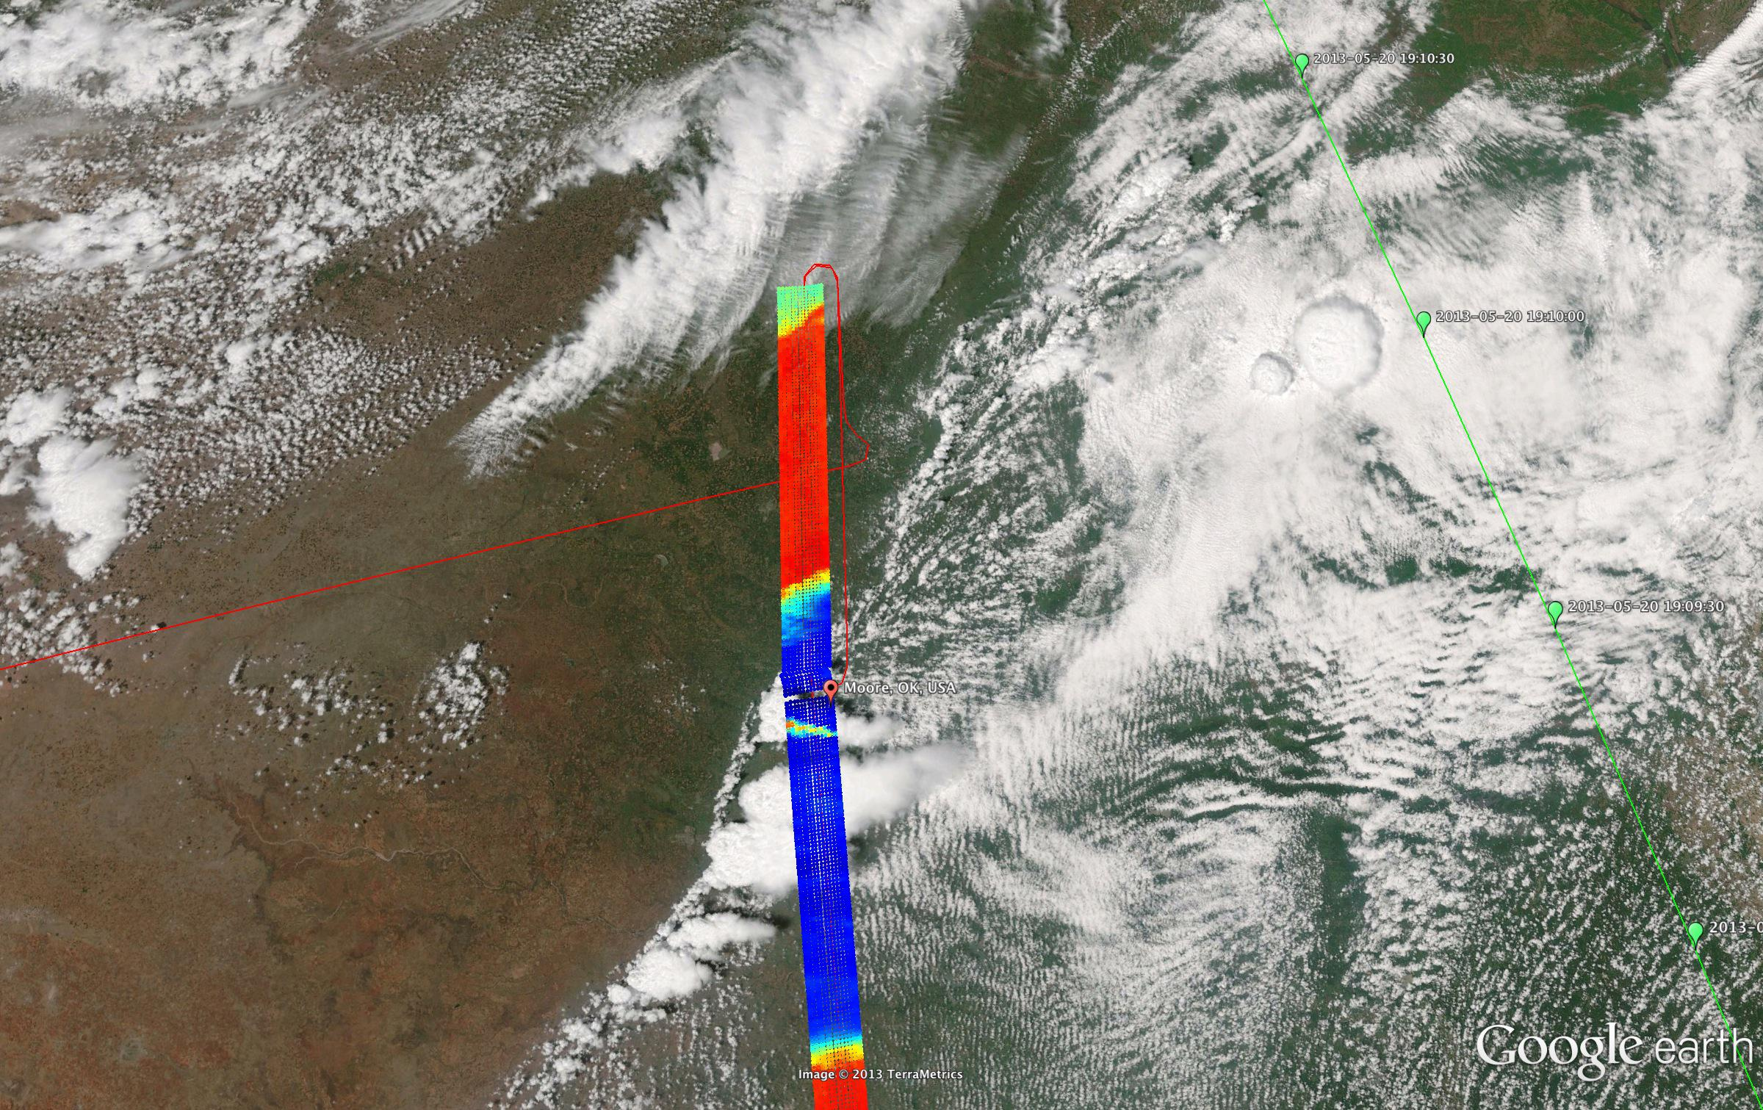
S-HIS 895-900 cm⁻¹ Brightness Temperature (200 – 320K)

Slide 8
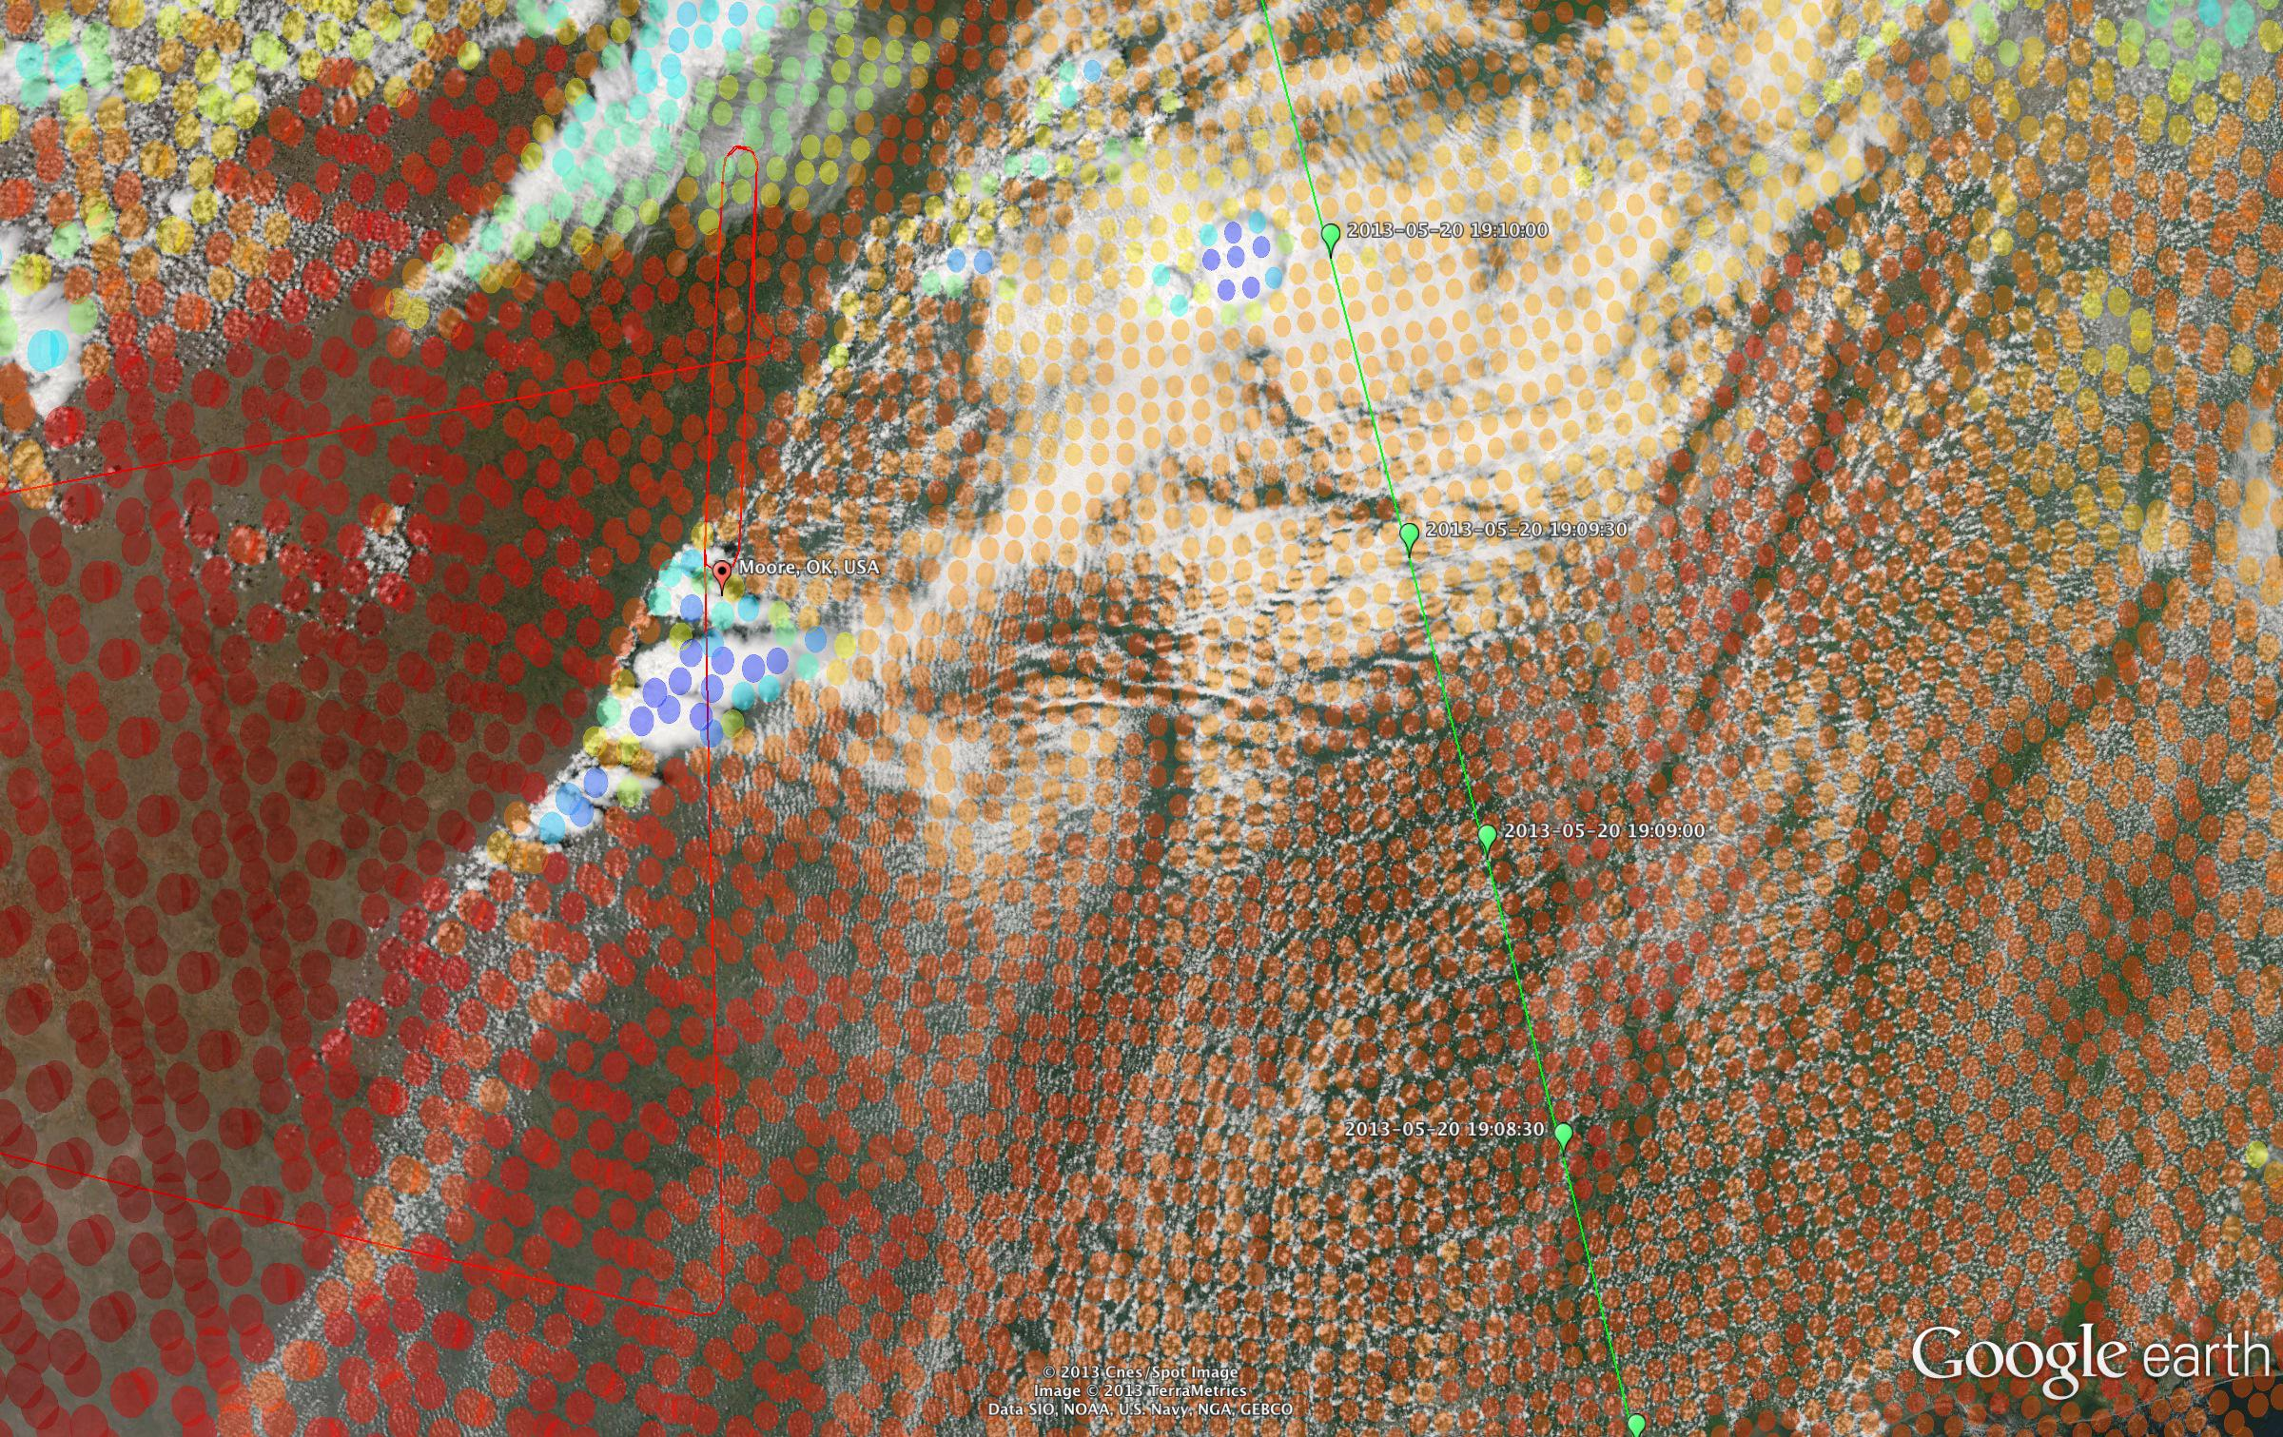
CrIS 895-900 cm⁻¹ Brightness Temperature (200 – 320K) ~19:09 UTC

